Slide 1
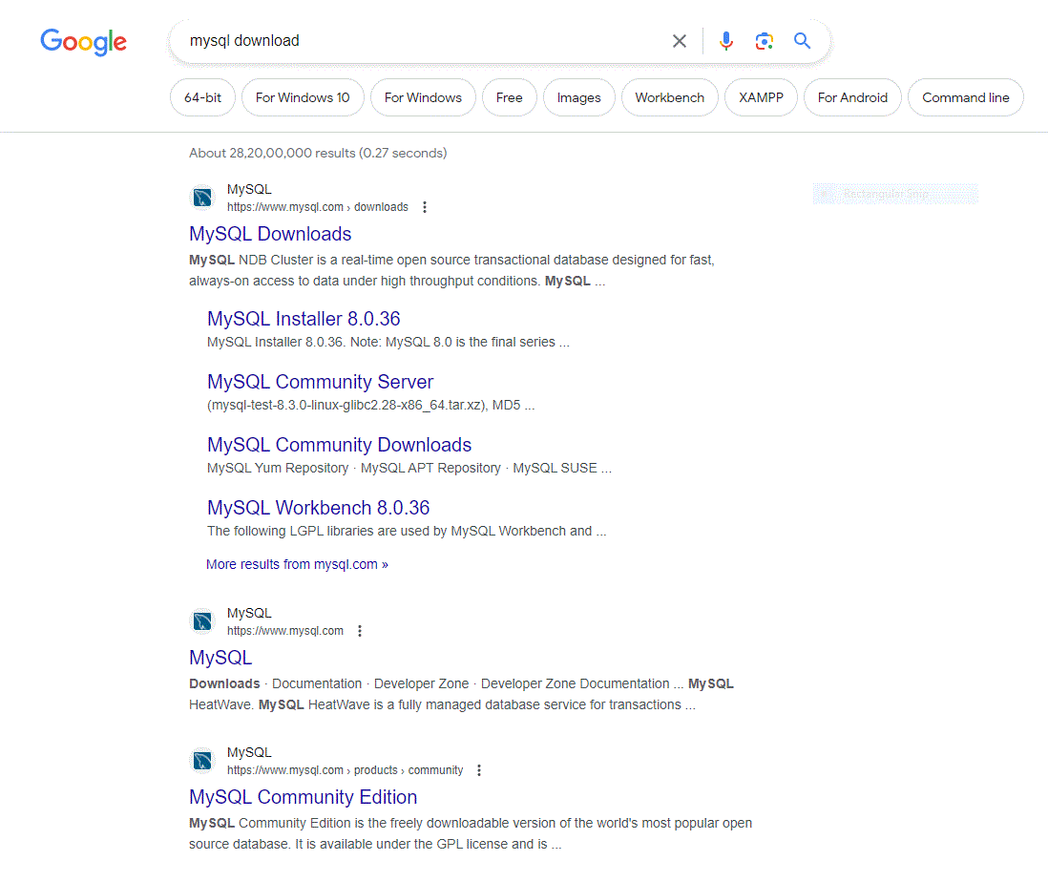
In google type mysql download then select the first link www.mysql.com/downloads

Slide 2
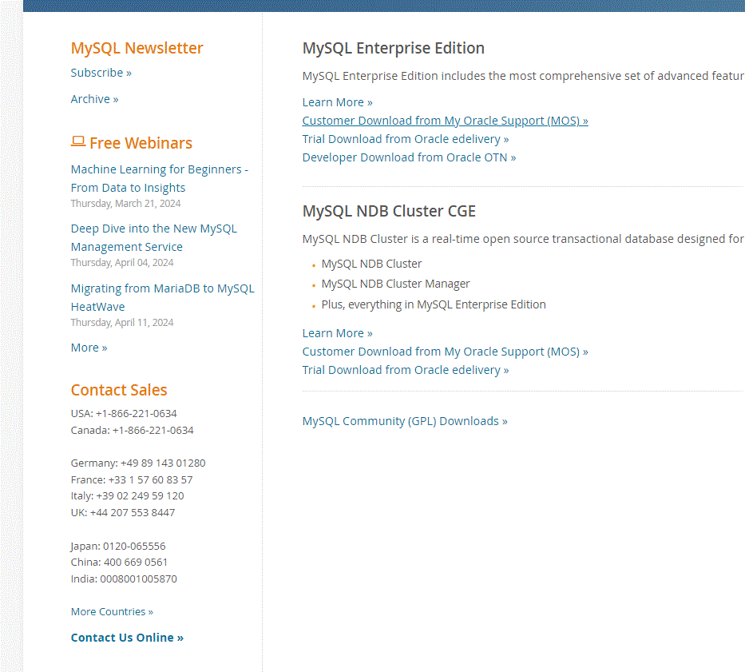
Then next click on mysql community downloads

Slide 3
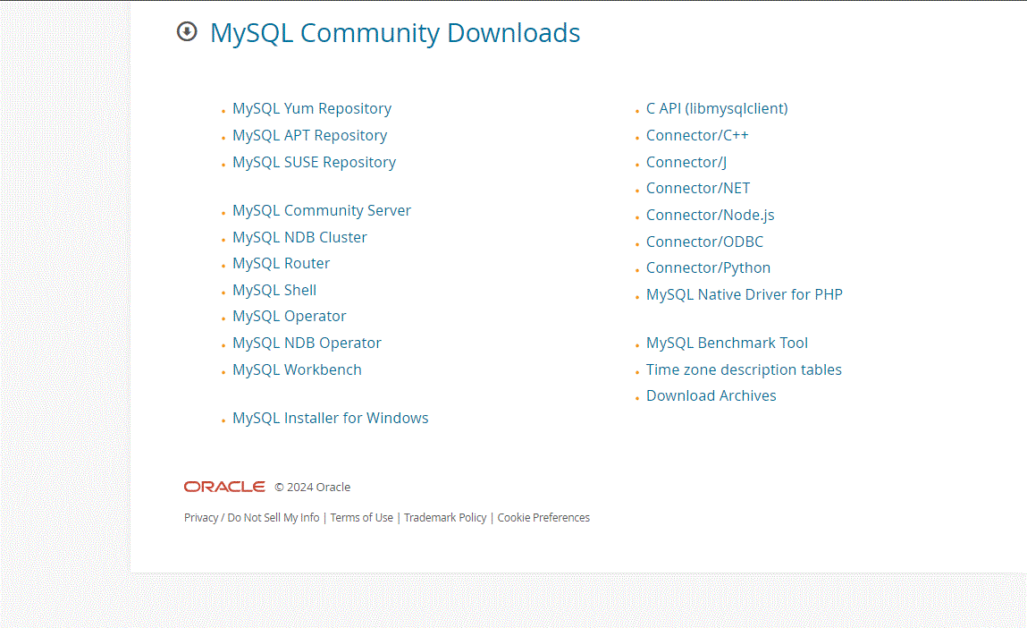
Here select mysql installer for windows

Slide 4
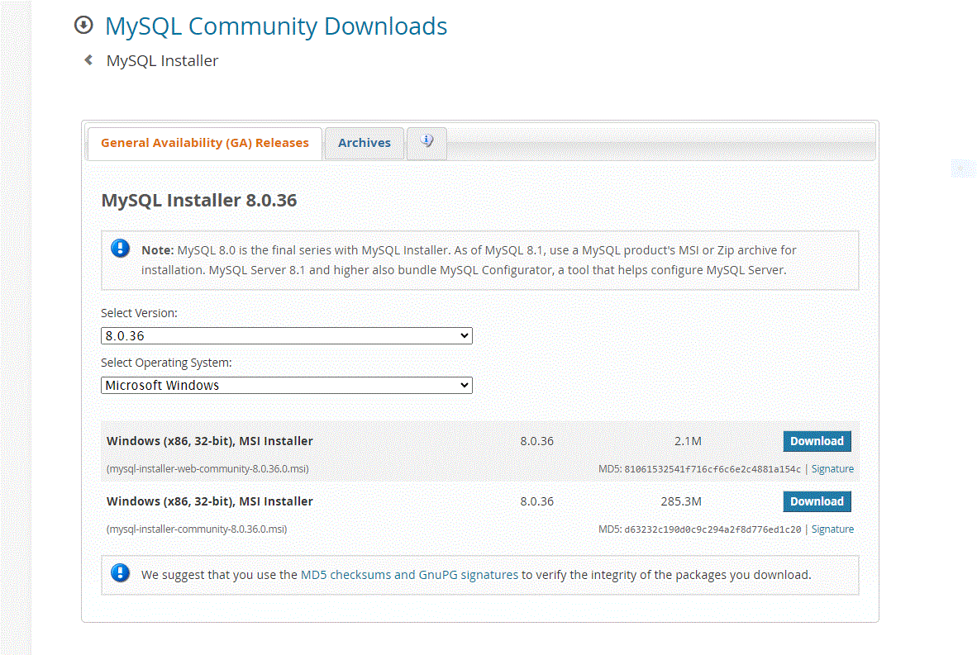
Here select 2.lM size msi installer

Slide 5
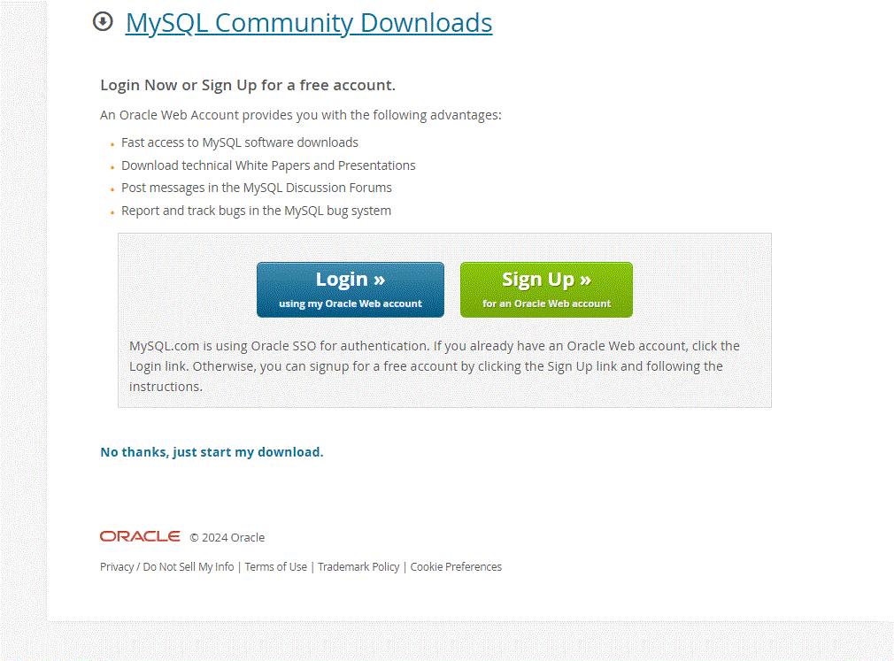
Here select No thanks,just start my download

Slide 6
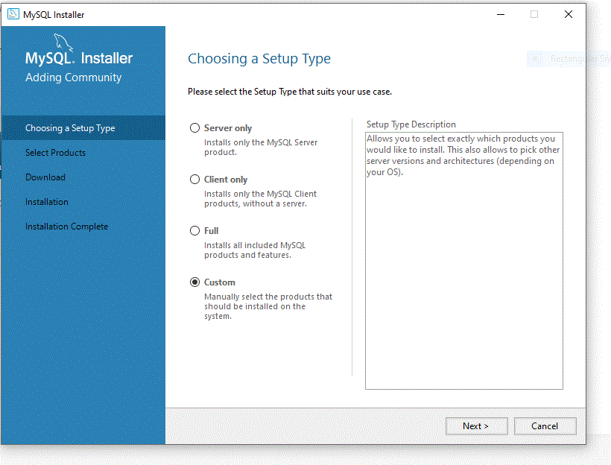
Next after download the file double click that file .Next click custom option

Slide 7
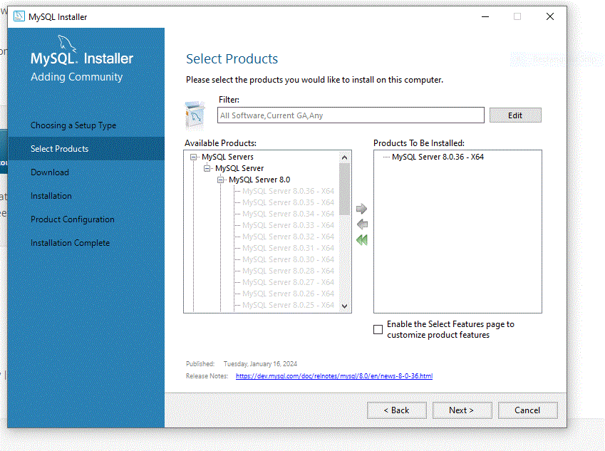
Next select mysql server 8.0.36 and workbench

Slide 8
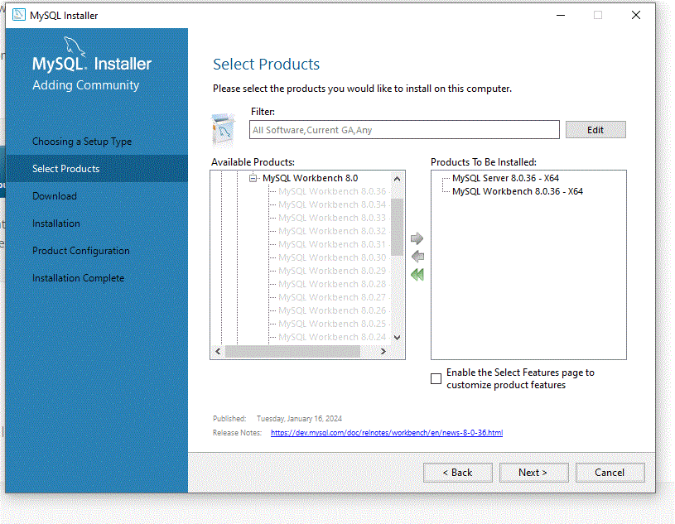

Slide 9
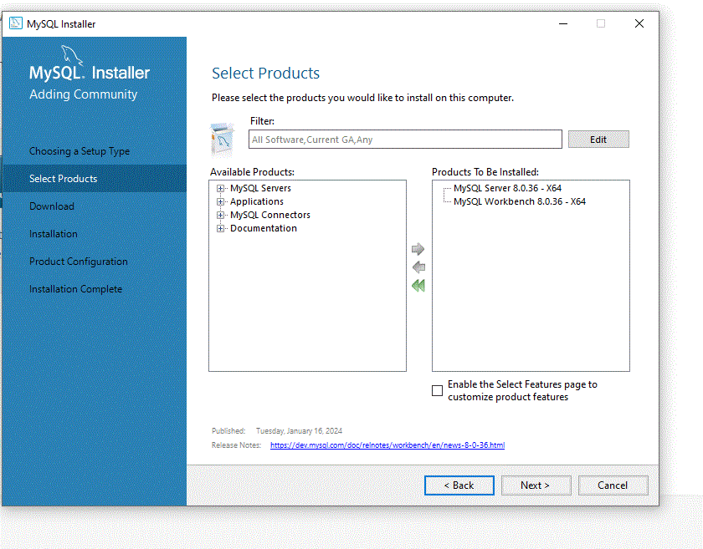
Then click Next

Slide 10
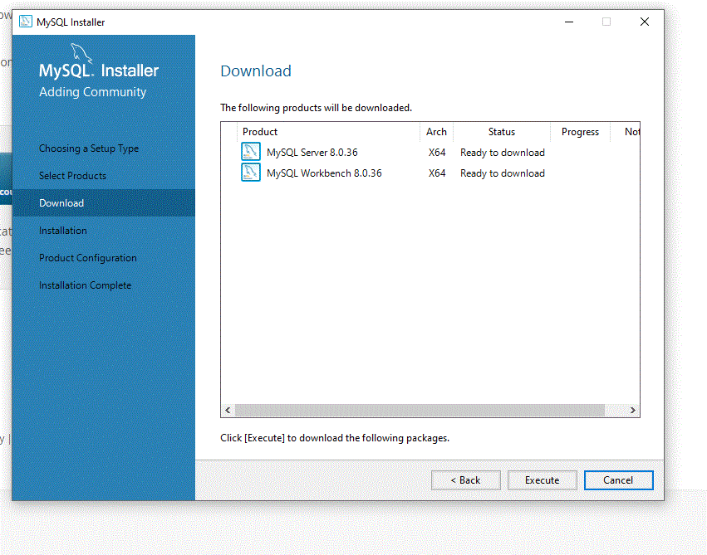
Then click Execute

Slide 11
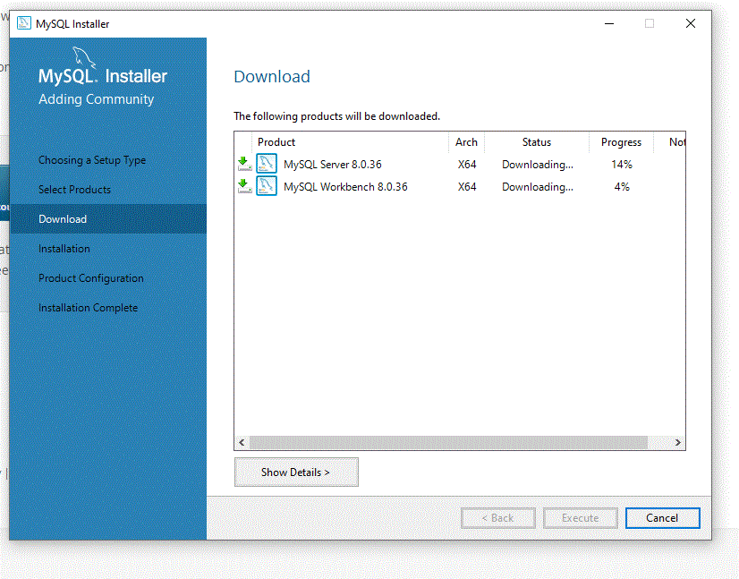
It will start download.
You should have internet connection while installation

Slide 12
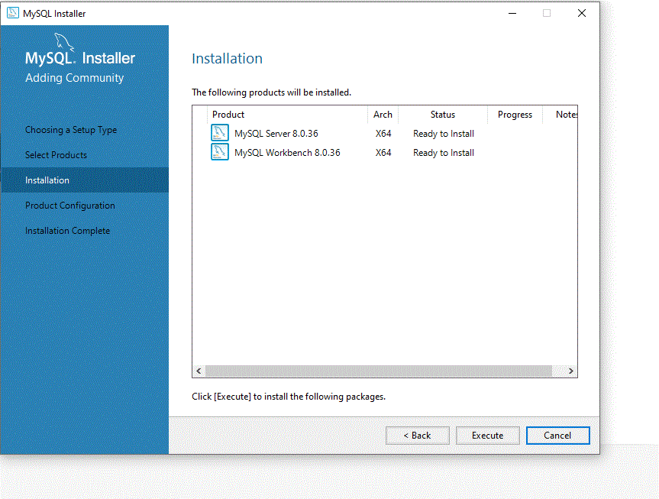
Then next click Execute

Slide 13
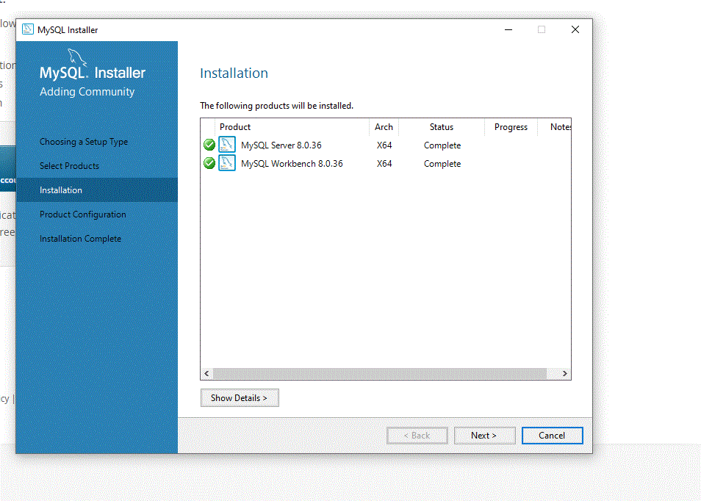
Then next click Next

Slide 14
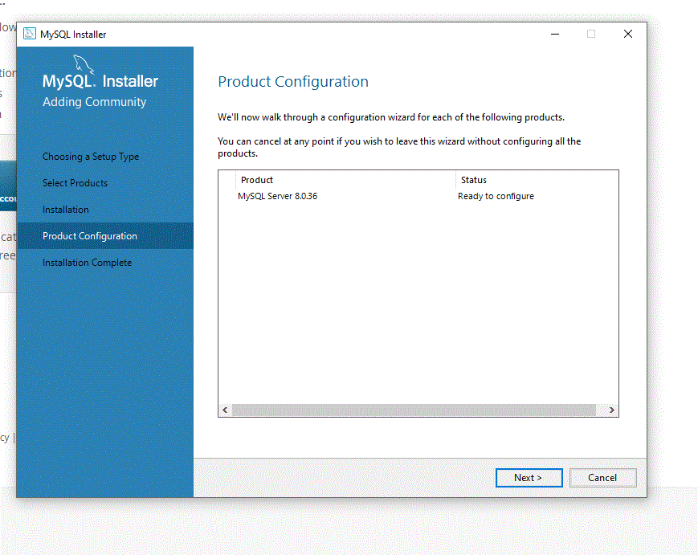
Then next click Next

Slide 15
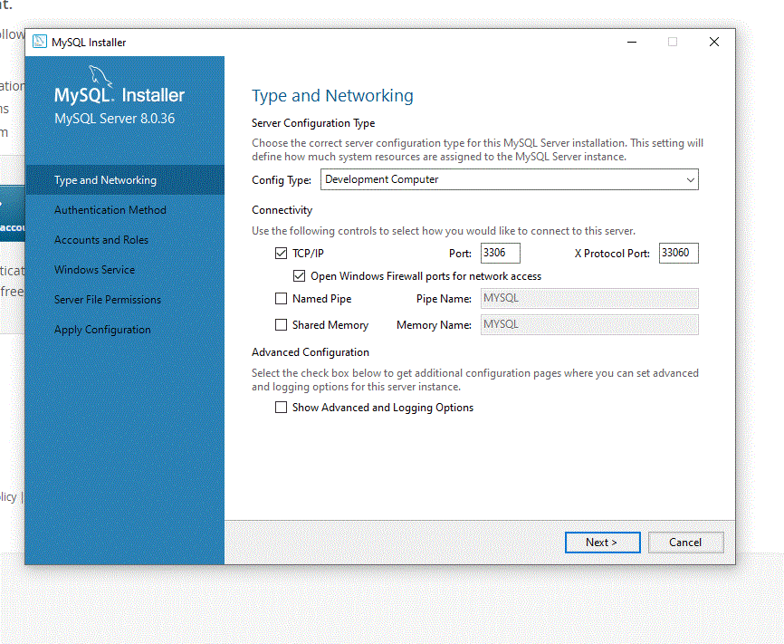
Simply click Next

Slide 16
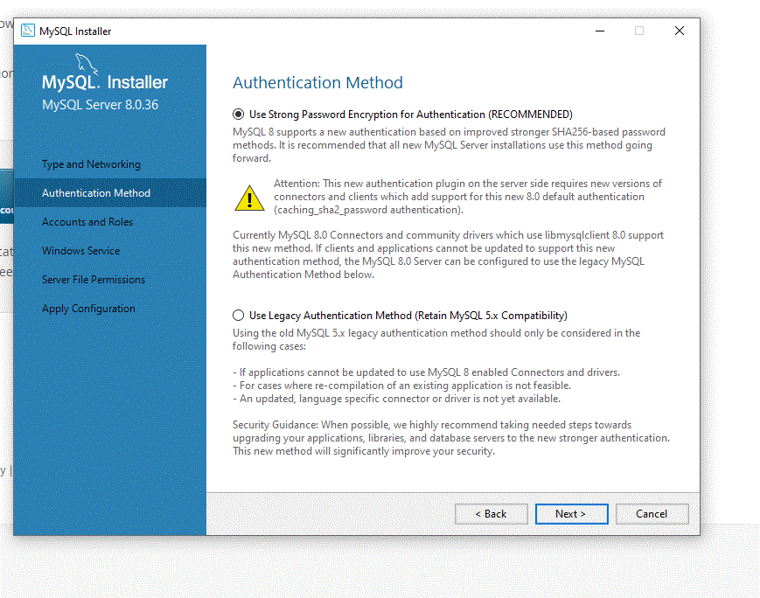
Click Next

Slide 17
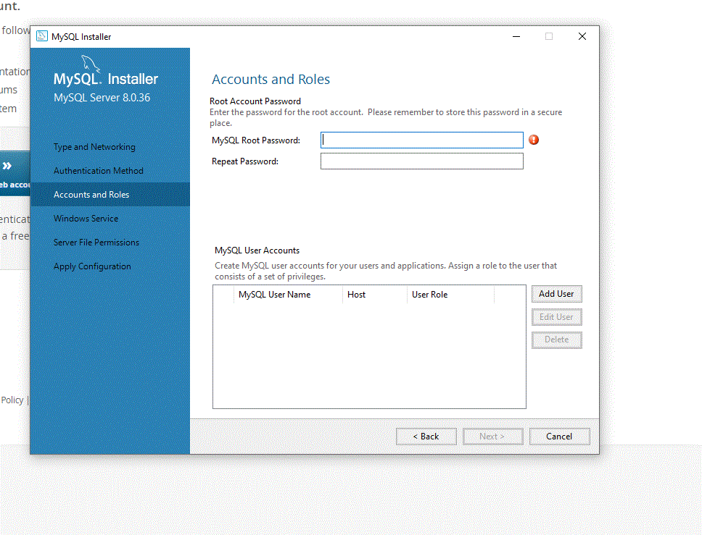
Here give root password

Slide 18
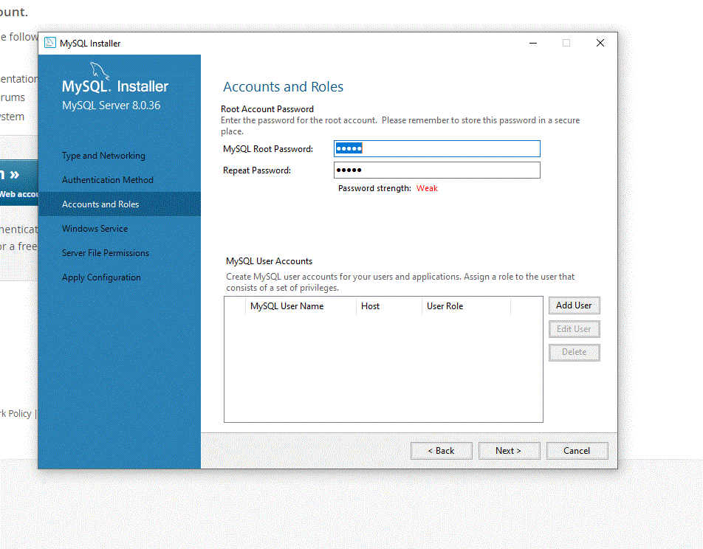
Then click Next

Slide 19
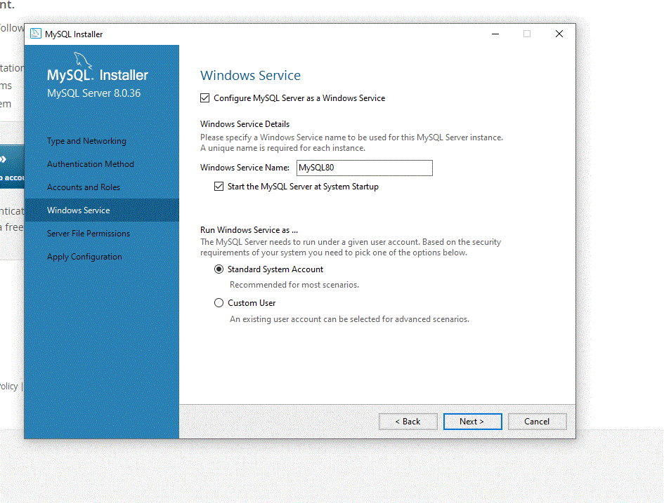
Click Next

Slide 20
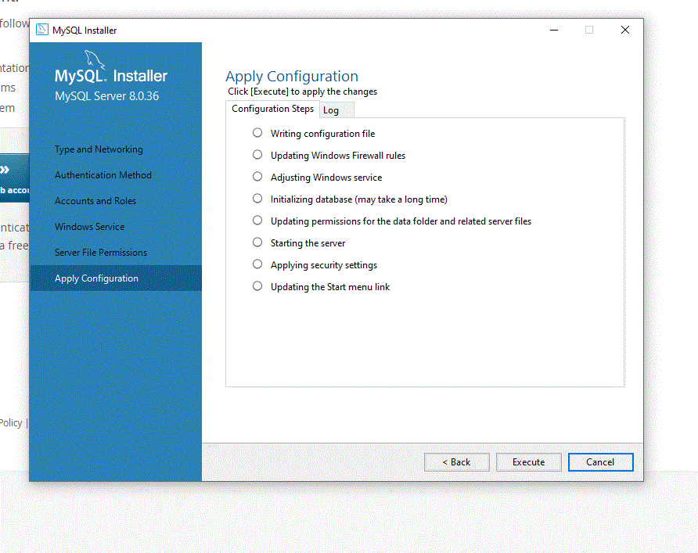
Click Execute

Slide 21
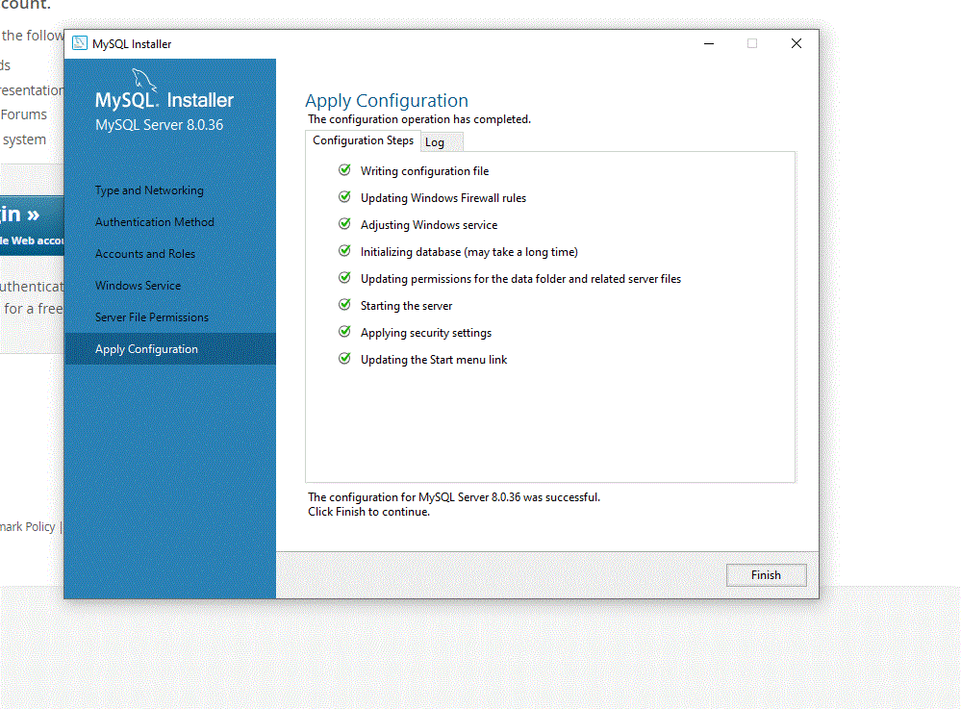
Click Finish

Slide 22
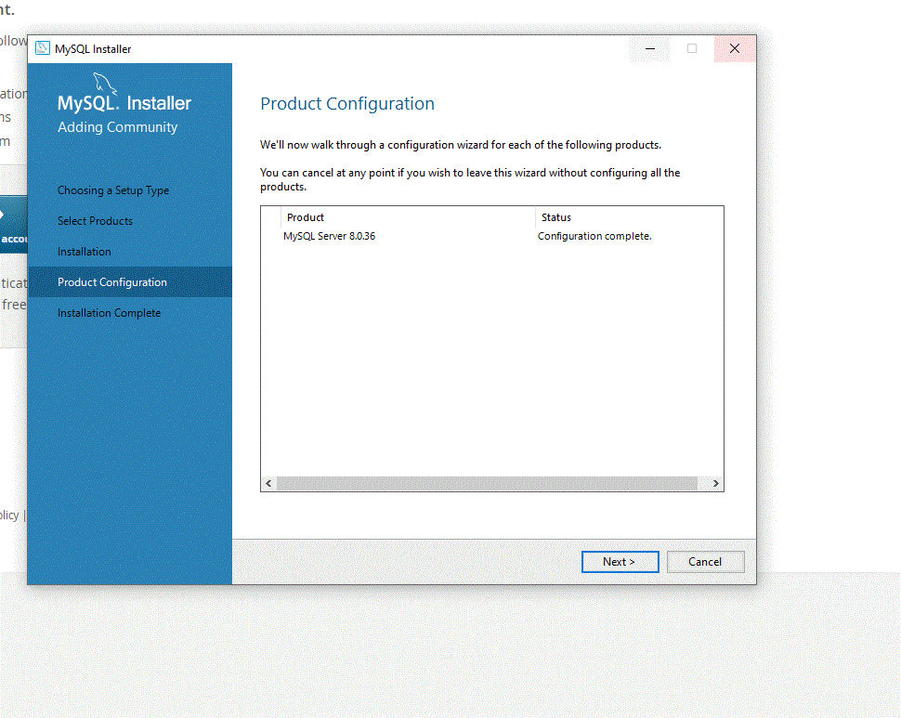
Click Next

Slide 23
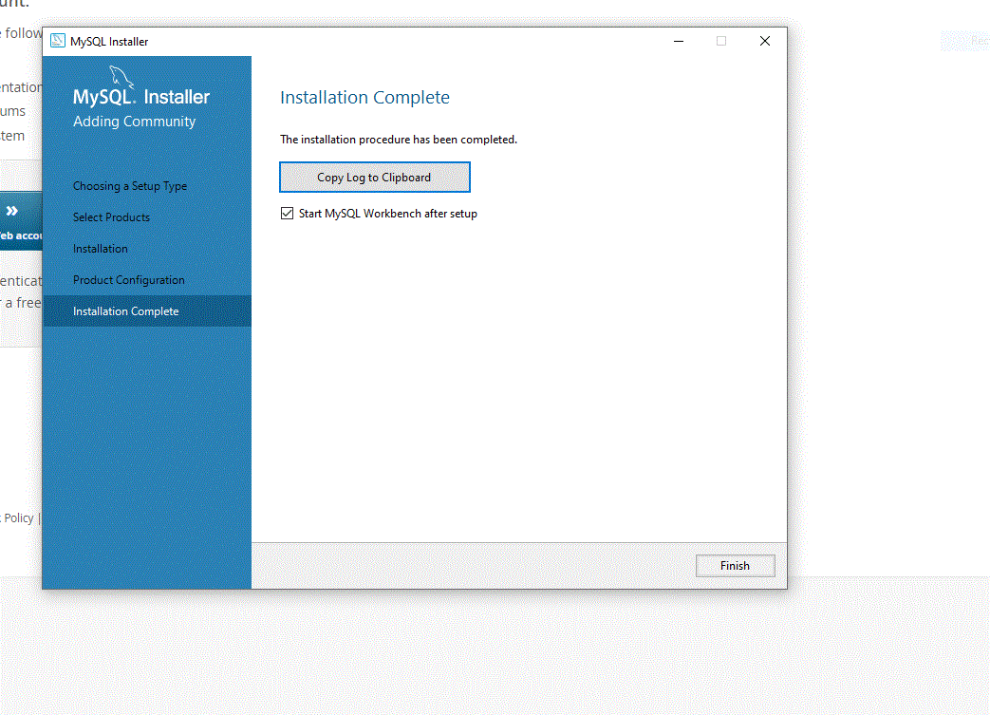
Click Finish

Slide 24
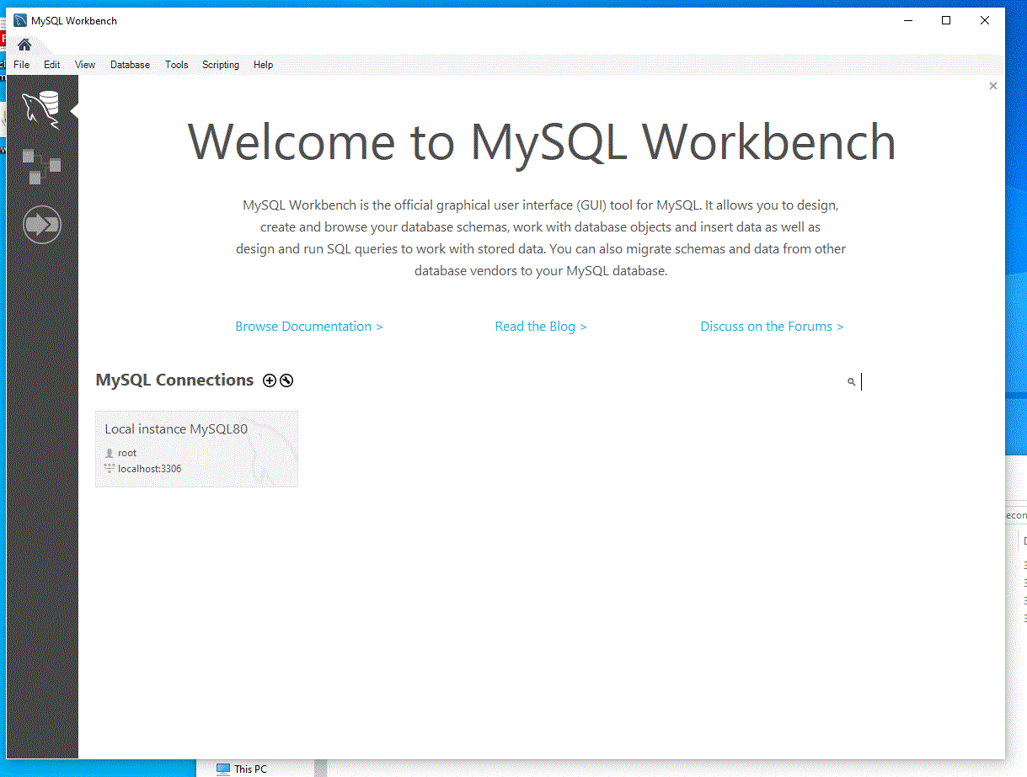
Here click local instance

Slide 25
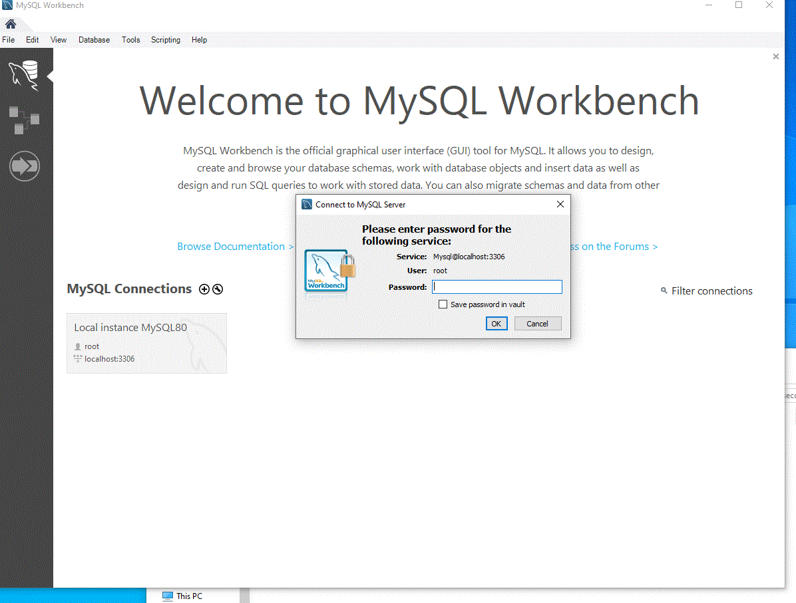
Give root password

Slide 26
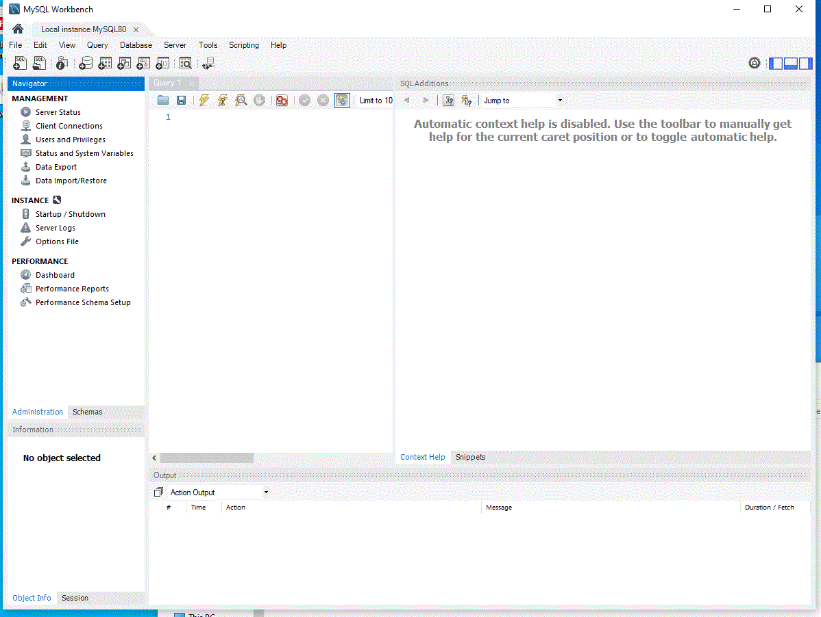
Here you can start work

Slide 27
